Slide 1


Power Up Your Configurable Apps using JavaScript 4x Functionality
Beth Romero
Kelly Hutchins
https://tinyurl.com/yyr3cx33
2019 ESRI DEVELOPER SUMMIT
Palm Springs, CA
Notes:
G243257 DevSummit 2019 Template for Esri staff

Slide 2
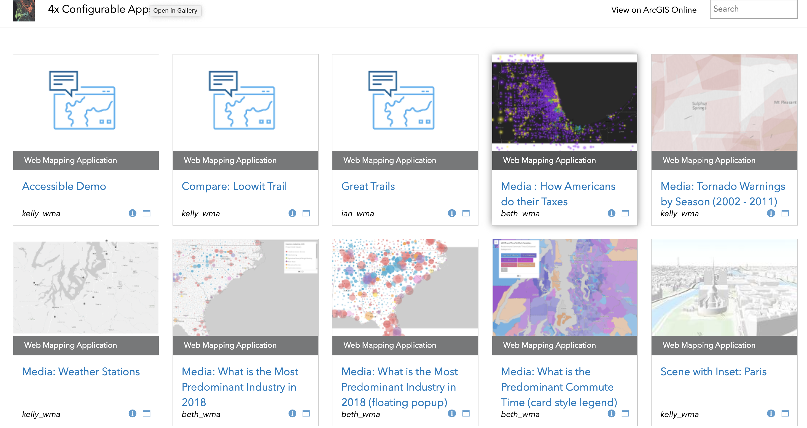
App Gallery

Slide 3
Github
Compare
Category Gallery
Minimal Gallery
3D Viz
Simple Scene Viewer

Slide 4
GitHub continued
Media
Styler
Scene with Inset
Interactive Legend (Coming Soon)

Slide 5

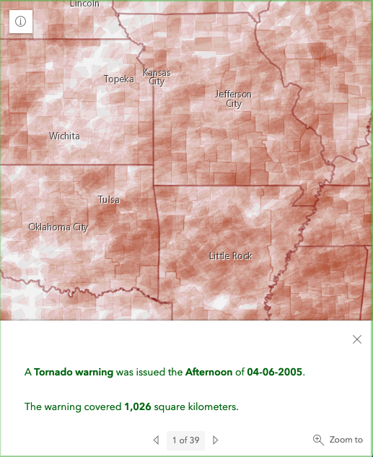
Responsive Apps
Popups
Expand Widget
Notes:
Kelly

Slide 6
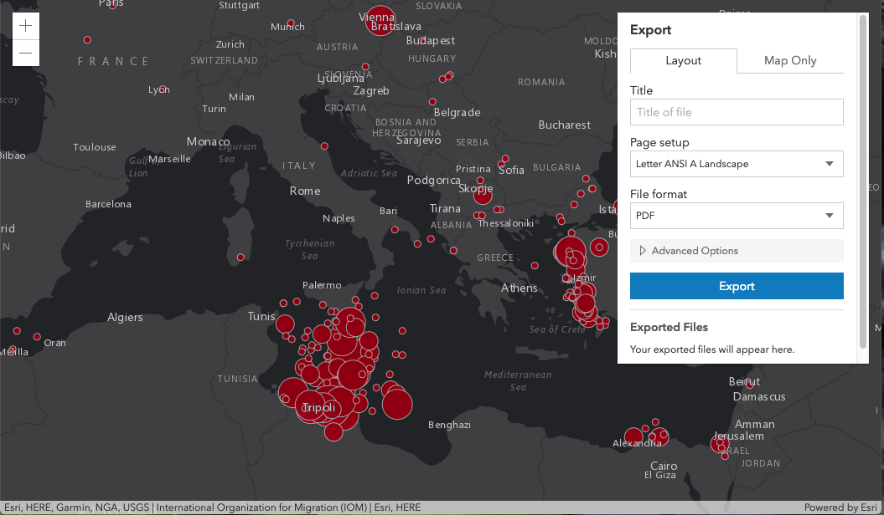
Accessibility
Notes:
I’ll create a demo video of tabbing through the 4.x widget showing they are keyboard accessible
Kelly

Slide 7
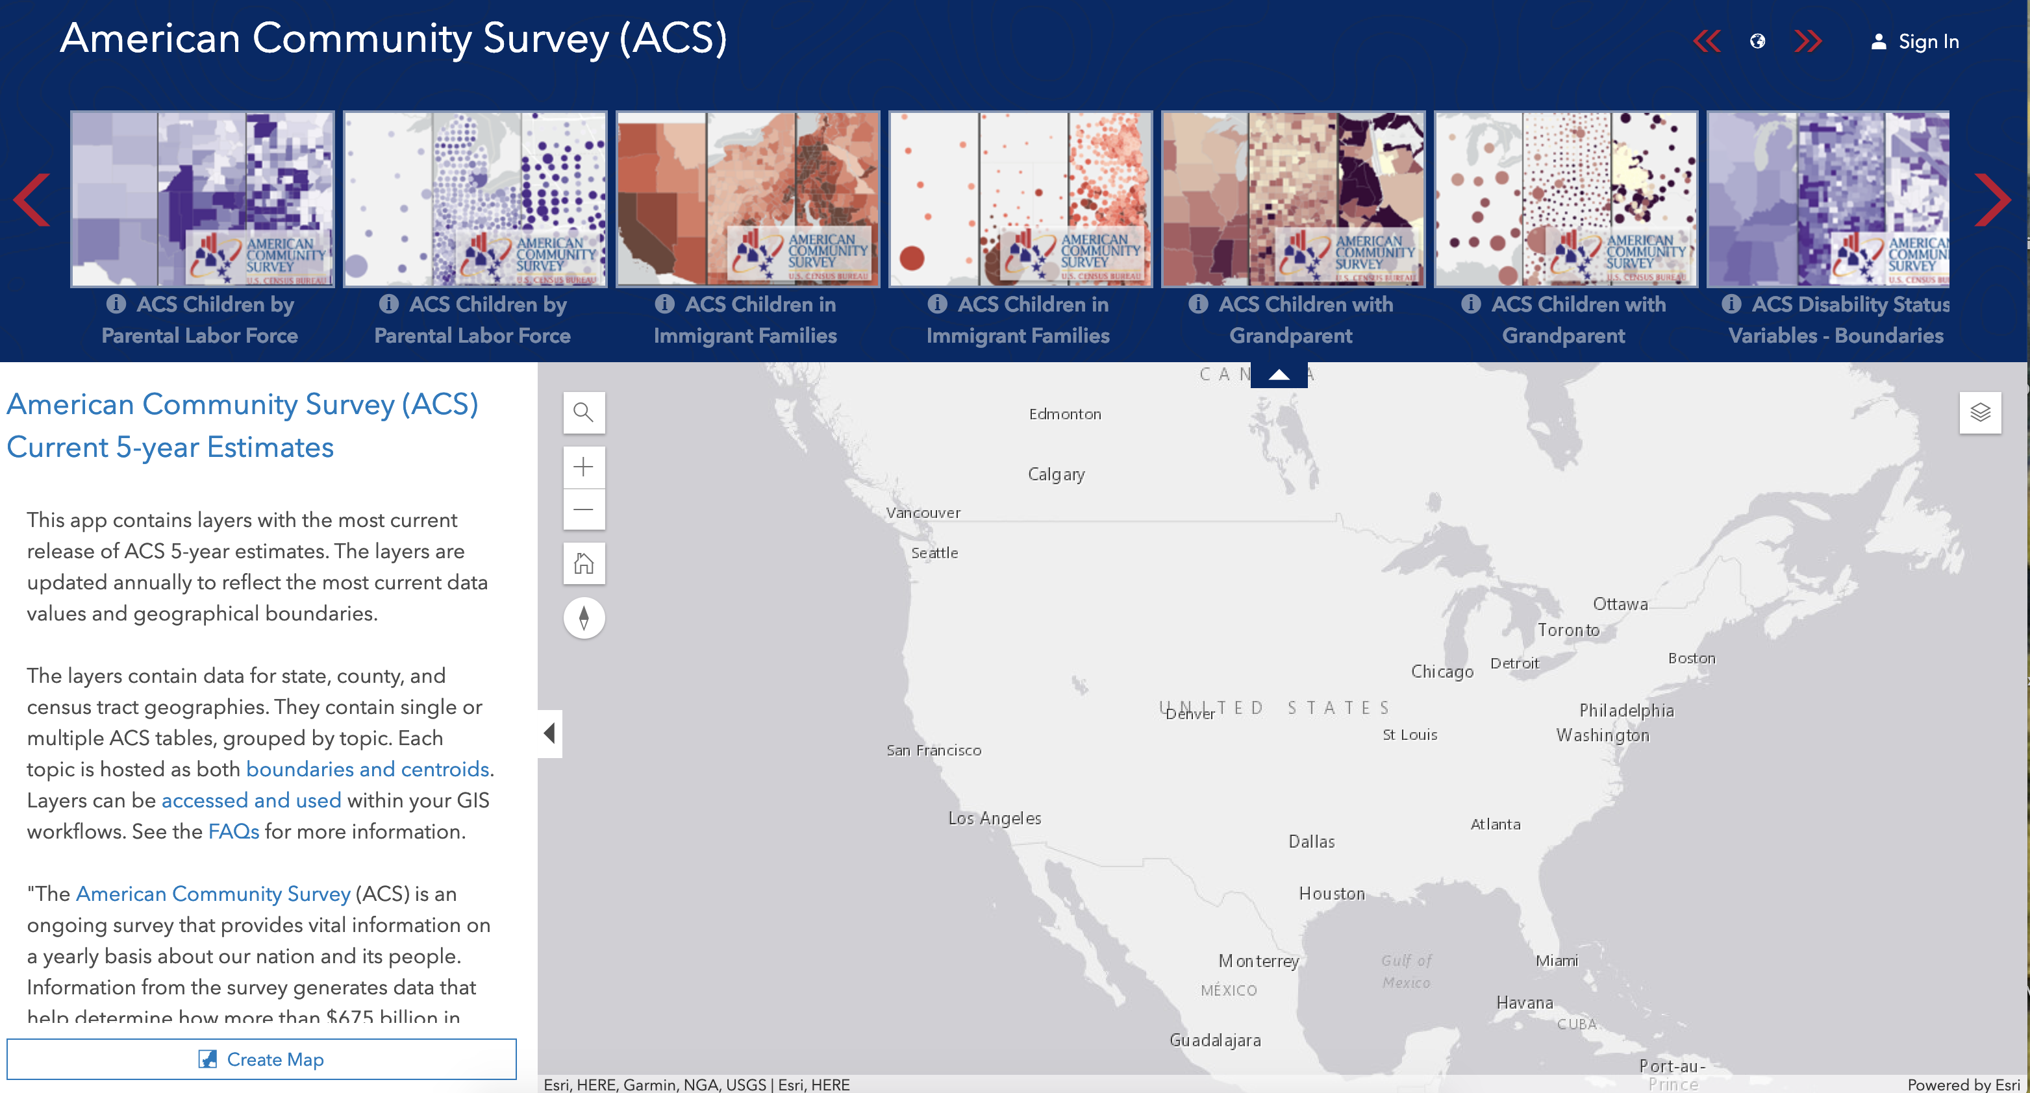
Add Layers
Layer Showcase

Slide 8
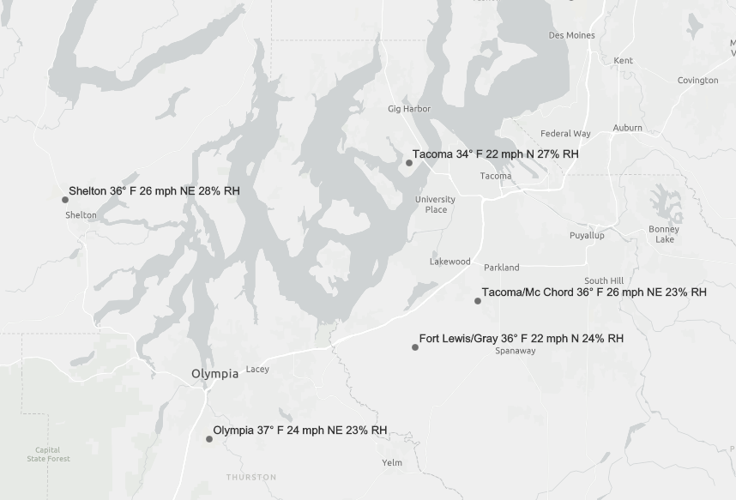
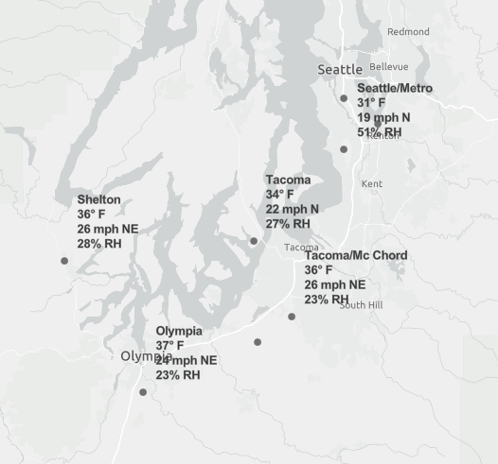
Stacked labels: Arcade new line expression
Online map viewer
4.X App
Notes:
Use new line arcade expression
Kelly

Slide 9
Popup: Attachments
List view (default)
Preview
Notes:
We can demo this one with the new capability on devext to create photo layers. In Media app users can choose (List view or Preview). KELLY LOOK AT THIS ONE
Kelly

Slide 10
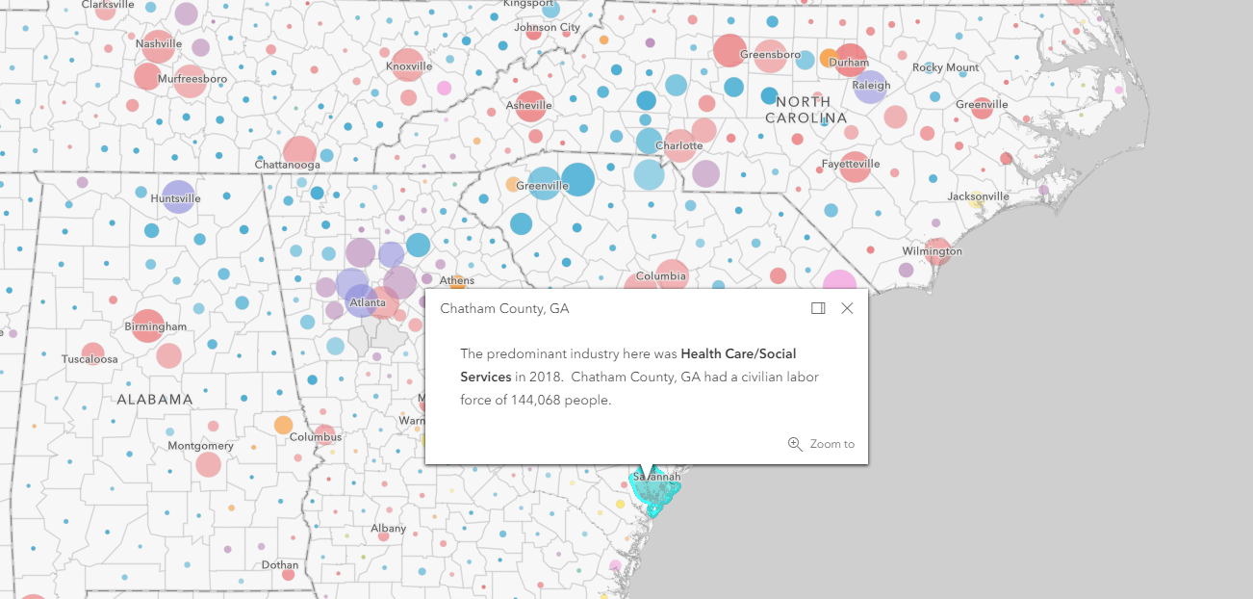
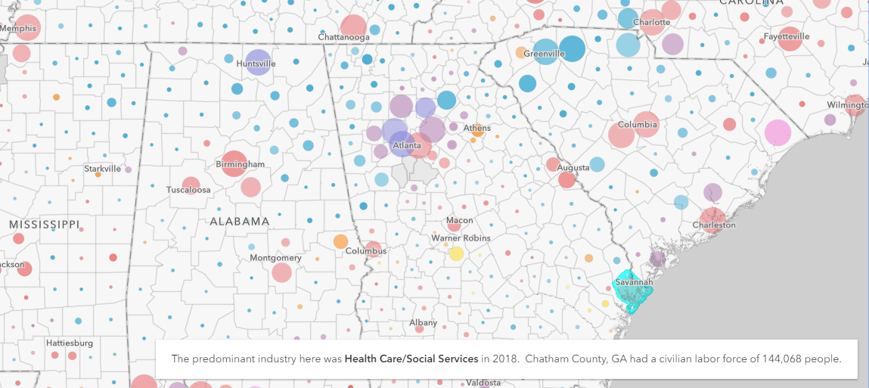
Popups : Dock and Hover
Dock
Hover – Floating
Hover - Fixed
Notes:
BETH
Hover fixed popup - https://webapps.maps.arcgis.com/apps/Media/index.html?appid=99d8822351cf4513bf2b248fe3e06865
Hover floating - http://webapps.maps.arcgis.com/apps/Media/index.html?appid=4f3dd42bf668447a9abe06099f5fa457
Docked – Styler https://webapps.maps.arcgis.com/apps/Styler/index.html?appid=ba335516fee1421cb5bb449f6e9b97f5

Slide 11
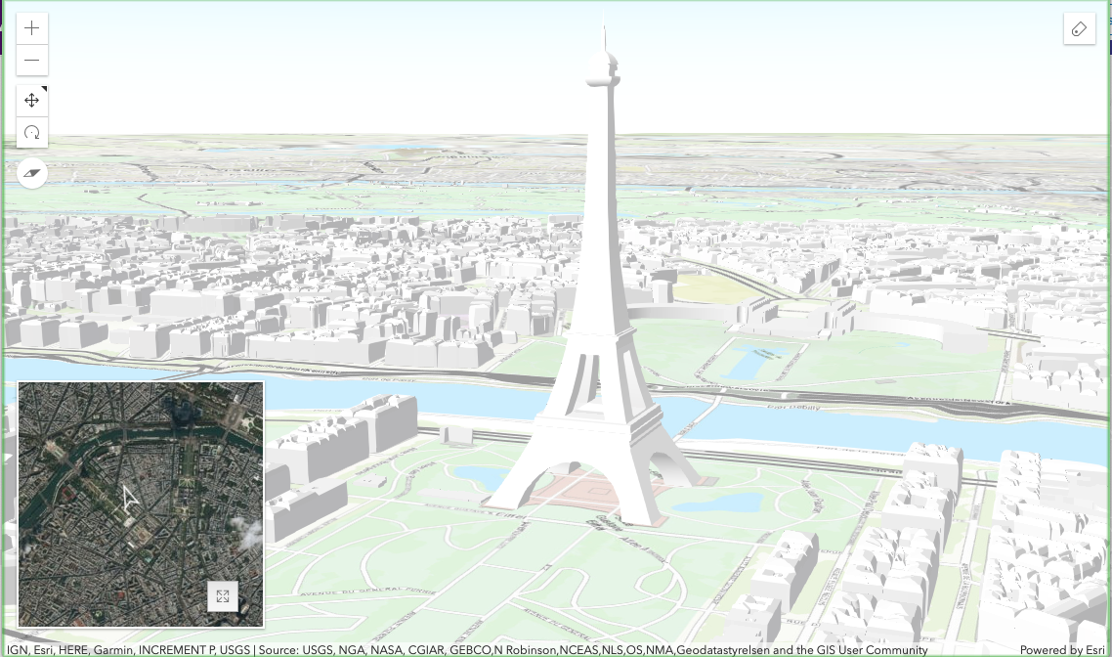
3D Maps
Compare 2d/3d
Inset 3d
Notes:
Beth

Slide 12
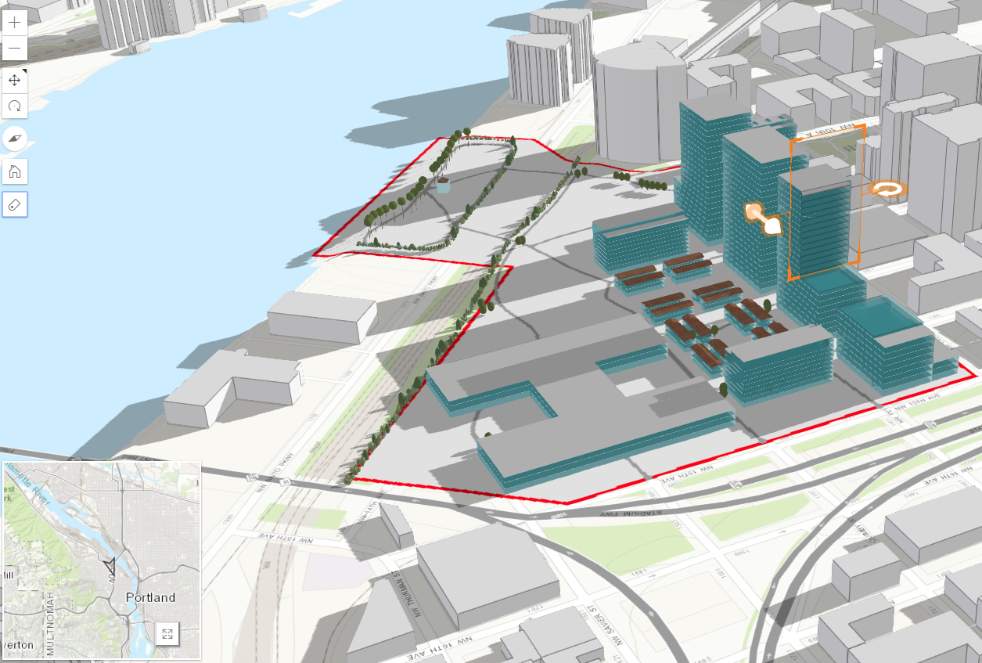
3D: Measure and Slice tools
Slice
Notes:
Slice App: Remove the buildings and the shadows update
http://webapps.maps.arcgis.com/apps/3DInsetMap/index.html?appid=0f553cdc22b14a25bc5bca2ac75397c3
BETH

Slide 13
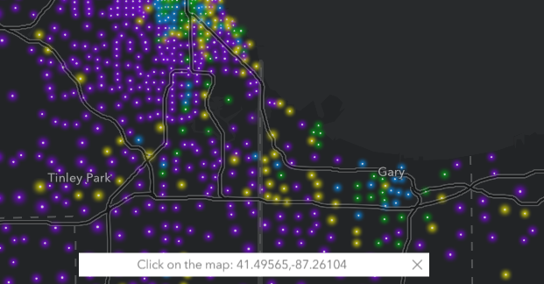
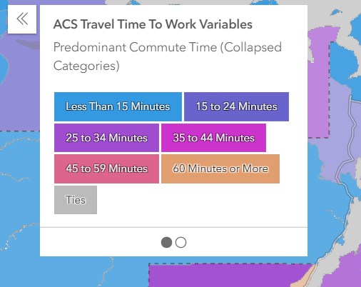
Other widgets
Coordinate widget
Card Style Legend
Full Screen
Notes:
BETH
Coords Widget - https://webapps.maps.arcgis.com/apps/Styler/index.html?appid=32412e57f2514b008740de00e77f4d2a
Legend Card Style and Full Screen - https://webapps.maps.arcgis.com/apps/Media/index.html?appid=0d609007027e41d3aff3ebcd451d3527

Slide 14
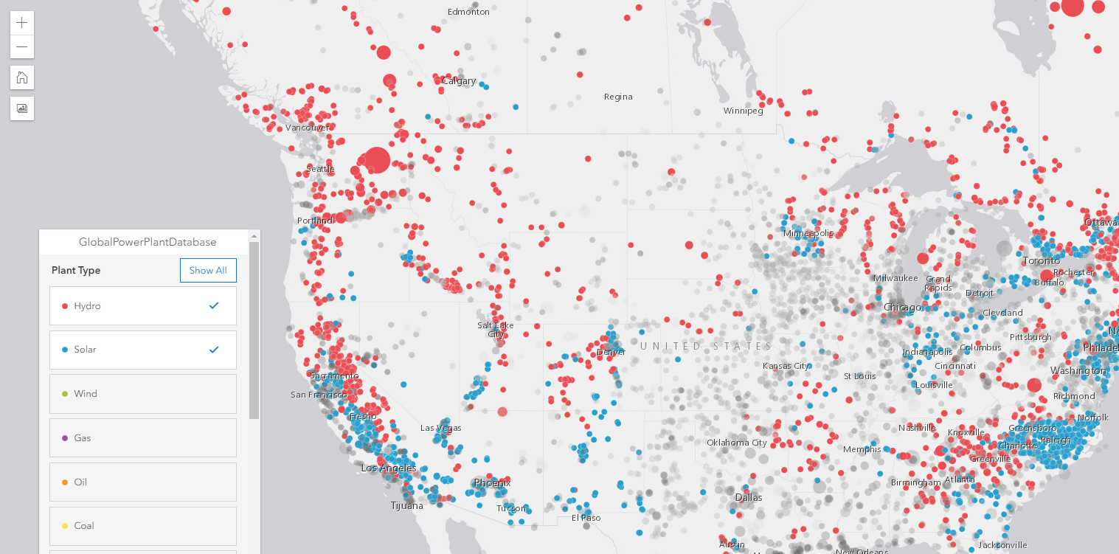
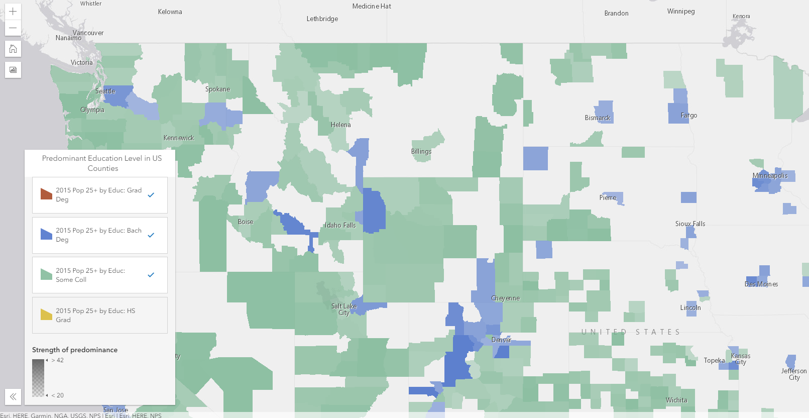
Interactive Legend & Screenshot
Mute
Filter with Screenshot
Notes:
BETH
Mute - http://nw-brews.mapsdevext.arcgis.com/apps/InteractiveLegend/index.html?appid=c898d6031ec149068a7d5654d5fe2240
Filter - http://holistic.mapsdevext.arcgis.com/apps/InteractiveLegend/index.html?appid=c46c08cf403f4d2a92152f60fbde92a8
Other if they are updated:
– *need to update* - http://holistic.mapsdevext.arcgis.com/apps/InteractiveLegend/index.html?appid=cb78492e805848cb9e5e4f8bf3225aa2
http://holistic.mapsdevext.arcgis.com/apps/InteractiveLegend/index.html?appid=4399a2eb130c4a1f83fb3a2ce104152e
- Docked
– http://holistic.mapsdevext.arcgis.com/apps/InteractiveLegend/index.html?appid=d9e6a75521a3411bb89bb05aba60e393

Slide 15
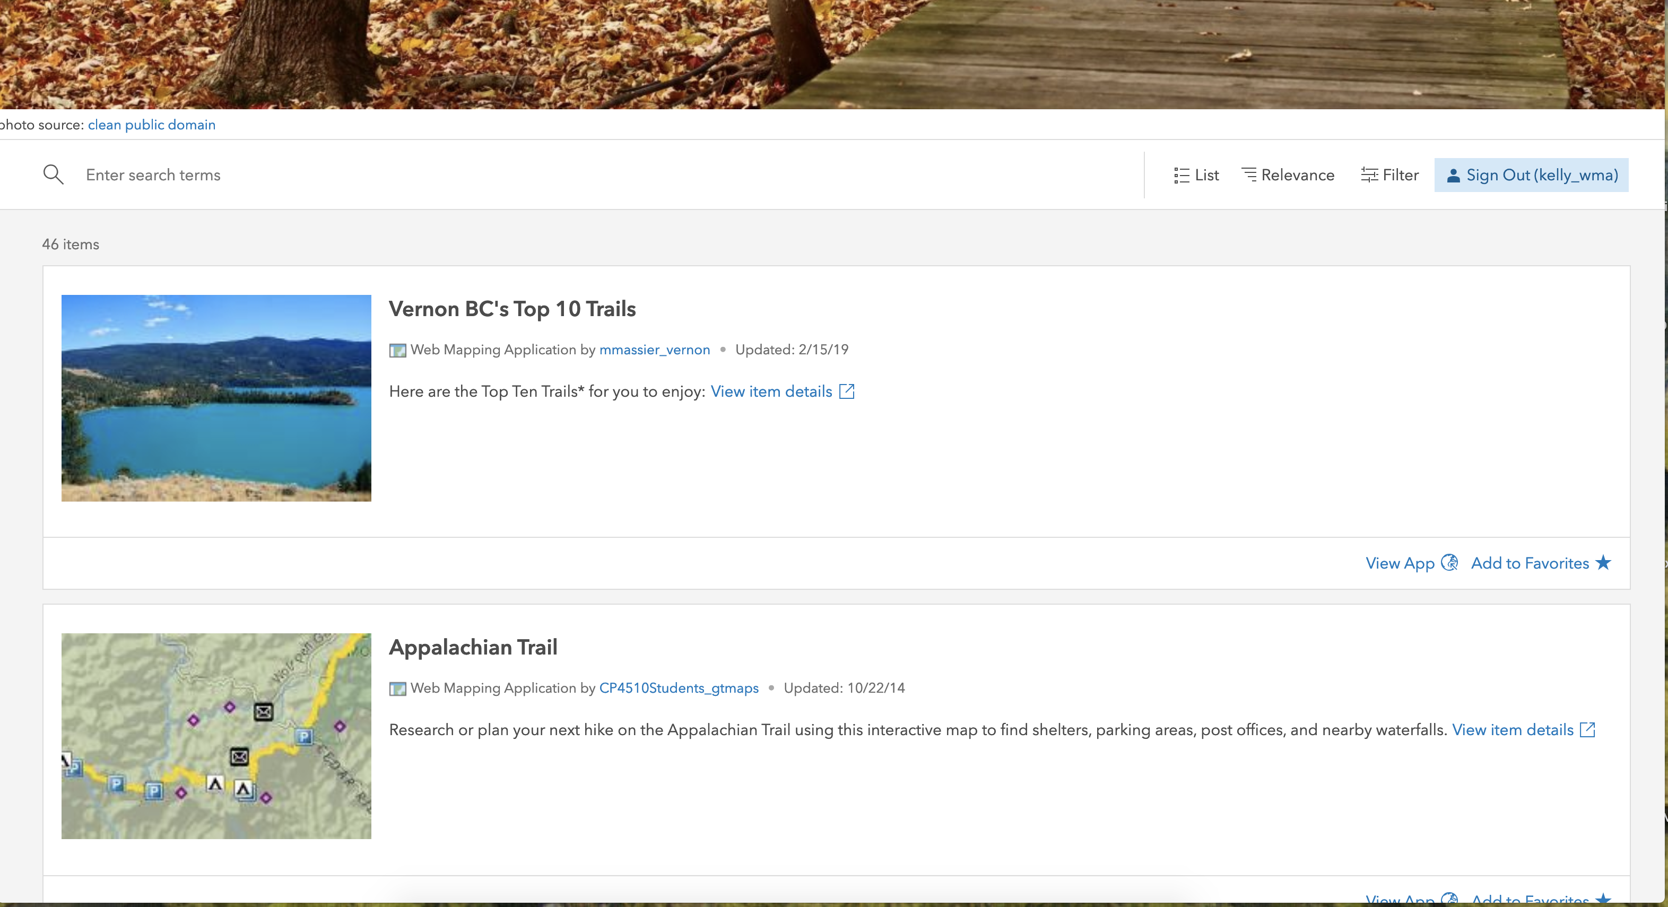
Category Gallery

Slide 16


Slide 17

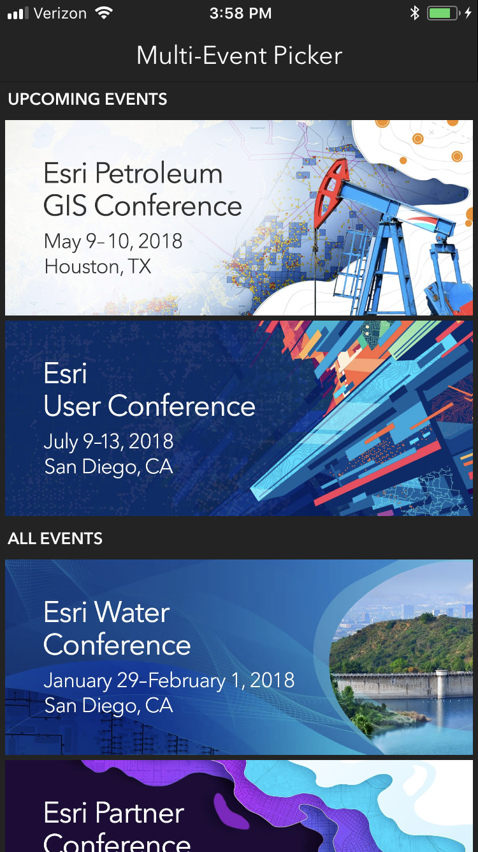
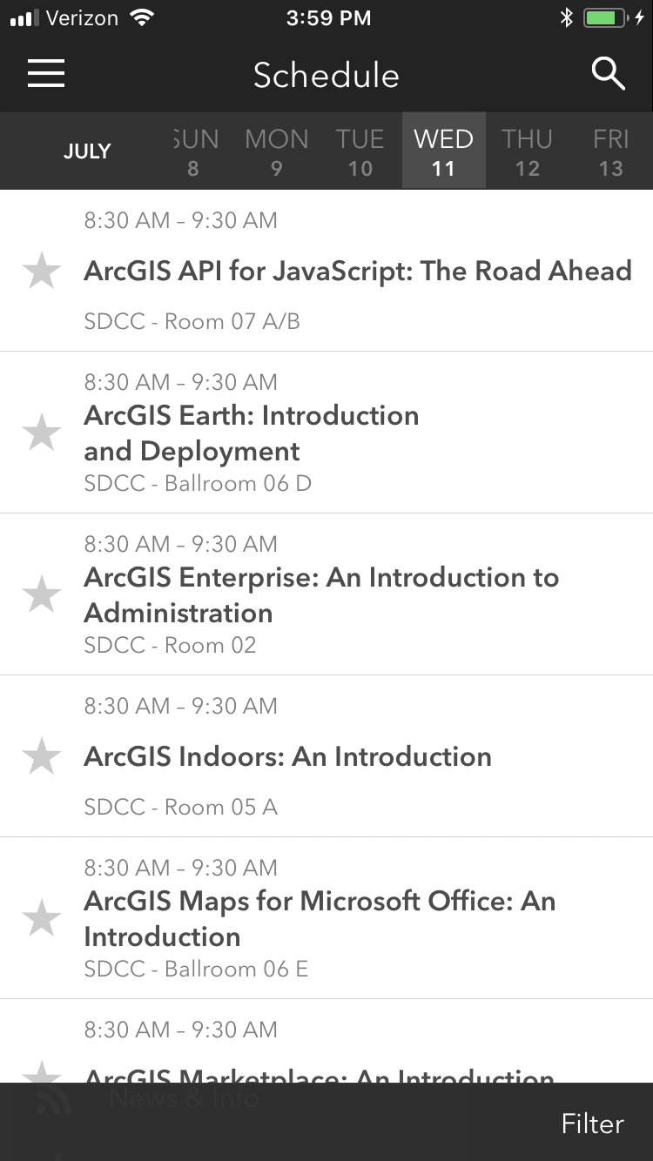
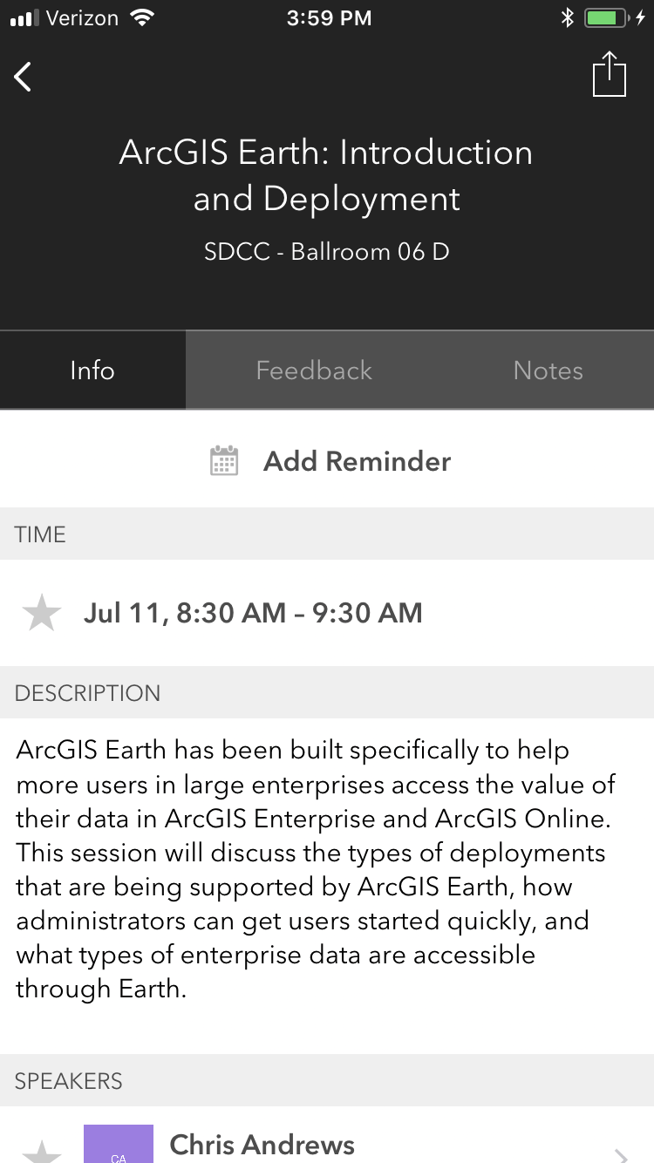
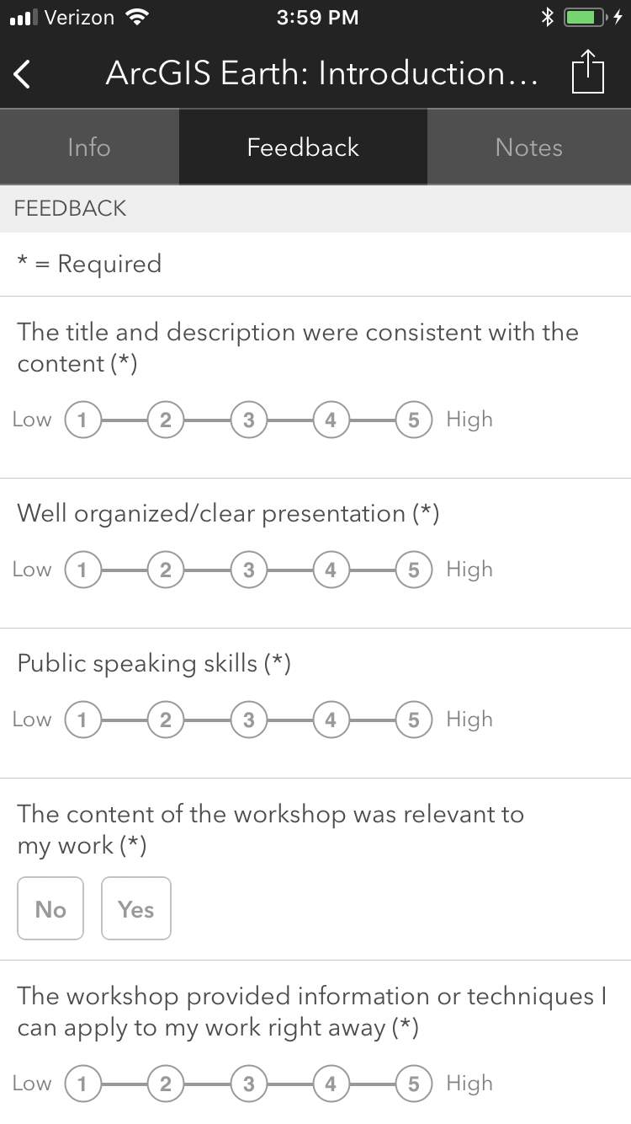
Please Take Our Survey on the App
Download the Esri Events app and find your event
Select the session you attended
Scroll down to find the feedback section
Complete answers
and select “Submit”

